Slide 1



ACE LET'S ACE IT! Artificial Computer Education Team_aa Abhigna KV & Ashwij Kumar Department of CSE

Slide 2
ACE -Artificial Computer Education
Learning is pivotal for a student's success in academics and life. The Digital Age is deeply shaping the way students learn and will also determine their future prospects. With the use of technology, we aim to provide students a platform where they can learn, engage and be excited about paving their own path to discover the world.
WHAT IS ACE?
ACE (Artificial Computer Education) is an automated education system, which uses technology to create a personalized learning experience for each student.
Artificial Intelligence is used to identify the learning pattern of the student. Then, a unique curriculum is formed to guide the student to learn at his/her own pace.
ACE provides an opportunity to the students to pursue their passion and achieve their goals. It instills a sense of satisfaction in them, and they will live a life with no regrets.

Slide 3
Intention behind the project
About 30 percent of the students indicate they are bored due to lack of interaction with teachers and 75 percent report material being taught is not interesting. Fewer than
2 percent of students said they are never bored in high school.
The same reasons for boredom could explain high drop-out rates. In the survey, about 20 percent of students said they had considered dropping out of school, giving some of the following reasons:
73 percent said, "I didn't like the school."
61 percent said, "I didn't like the teachers."
60 percent said, "I didn't see the value in the work I was being asked to do."
25 percent said, "No adults in the school cared about me."
Students want more interactive classes and prefer activities that involve interaction with teachers and peers.
Source: www.livescience.com

Slide 4
What is our Motive?
Revolutionize the current education system:
By providing a platform for children to study what they love, and help them pursue the same in their future. Our goal is to offer highly adaptive, engaging and effective education.
The students can choose from an ocean of domains, ranging from Computers to Crafts, and Singing to Science. And this choice is done by their own discretion. There is also an option to choose an elective of their own choice. Helping the student find their interests and hidden talents, and supporting them will result in a successful life!
In the end, all that matters is Happiness. Living by your own choices, making your own decisions, and living life without regrets is something that everyone desires.

Slide 5
What is wrong in the current Education System?
Options
Not all courses are available in all institutes, due to lack of teaching professionals.
Practical Knowledge
The current system falls short in providing practical exposure. It's easy to forget what you read, but it is almost impossible to forget what you experience.
Social Etiquette and Life Skills
Minimal importance is given to Social Etiquette. Good manners show the best you have to offer and encourage others to be their best.
Motive of Exams
Only answer to a question is asked, rather than a solution to a problem. Marks are used to judge a student.

Slide 6
Originality of Assignments
Assignments given are same throughout, and students tend to copy from peers, or plagiarize from the Internet.
Oratory skills
Students are not confident to speak before 50 people, or give a presentation.
Non mainstream career options
Mindset of students is diverted to become doctors or engineers.
Outdated Syllabus
Science books do not talk about things discovered or invented in the recent past.
Reservation
Truly talented students do not get the chance they deserve due to reservation system.

Slide 7
How does ACE solve this?
AI-Based Personalized Learning
ACE is an automated education system which offers personalized learning for each student with an education that is highly adaptive, engaging and effective. With the help of Artificial Intelligence, the learning pattern of the student is identified and a unique curriculum is created to assist the student to learn at his own pace.
Ocean of options to choose from
The student has the liberty to choose the subjects he loves and of his/her interest. A wide range of options are available for the student to choose from, ranging from Physics to Painting, and Geometry to Drama.
Along with the the core subject, there will be an elective of his/her choice. This could be a hobby or any other subject, which the student loves to do.

Slide 8
Inclusive of Fundamental Subjects
Apart from core and elective subjects, mandatory subjects like Maths, Science, Social Etiquette and Language are included, as these subjects are the most fundamental subjects and shape a person's life.
Practicality in subjects
Hands on learning and practical exposure is given high priority.
Importance of Social Etiquette & Life Skills
At ACE, we give utmost imortance to Social Etiquette & Life Skills. Here, the child is extensively educated on the customary code of polite behaviour in the society.
The student is taught how to value and respect others. He/She is made to realise the importance of promoting kindness, consideration, and humility. Etiquette gives the confidence to deal with different situations in life.

Slide 9
How are students selected?
During the registration process, the student has to fill in all the neccessary details. The details can also be edited later.
After registration, the student has to choose his hobbies, one of which would be an Elective. Then he/she is asked to choose a subject they are interested to pursue. This will be their Core subject. There is an option to choose one or more Core electives.
Based on the choices done, a test will be conducted. The solutions of the student will be thoroughly evaluated. Extensive evaluation is done in order to get a deep understanding of the child. Once the student clears the tests, he will be given access to The ACE Application. Based on the results, the child will be allotted a personalized routine to follow.

Slide 10
What are the Funtionalities of The ACE Application?
Classroom
This is the most important aspect of the application. All subject related content is available here. The student can browse through the lessons and attend letures. Multiple workshops, webinars, competitions and quizzes are regularly conducted here, where the student can explore and keep themselves curious.
Schedule
Weekly schedule can be viewed here. This schedule is varied every week according to the student's learning pattern. Timings can be altered according to the student's will.
Contents
All the topics to be taught are listed here in this section.

Slide 11
Progress
There are two buttons here which indicate the progress of the student.
Current Progress
The students can view their current progress here.
Future Progress
The students view their future progress, which is predicted using Machine Learning algorithm (Random Forest).
The data collected will be used for further research on the learning style of each student. By identifying their learning patterns, the coaching can be further personalized to each student.
All in all, ACE aims to provide an incredible, one of a kind learning experience, which develops students' knowledge from the very roots, giving them in depth understanding of a subject that they love.
Come, join hands with ACE and together, LET'S ACE IT!

Slide 12
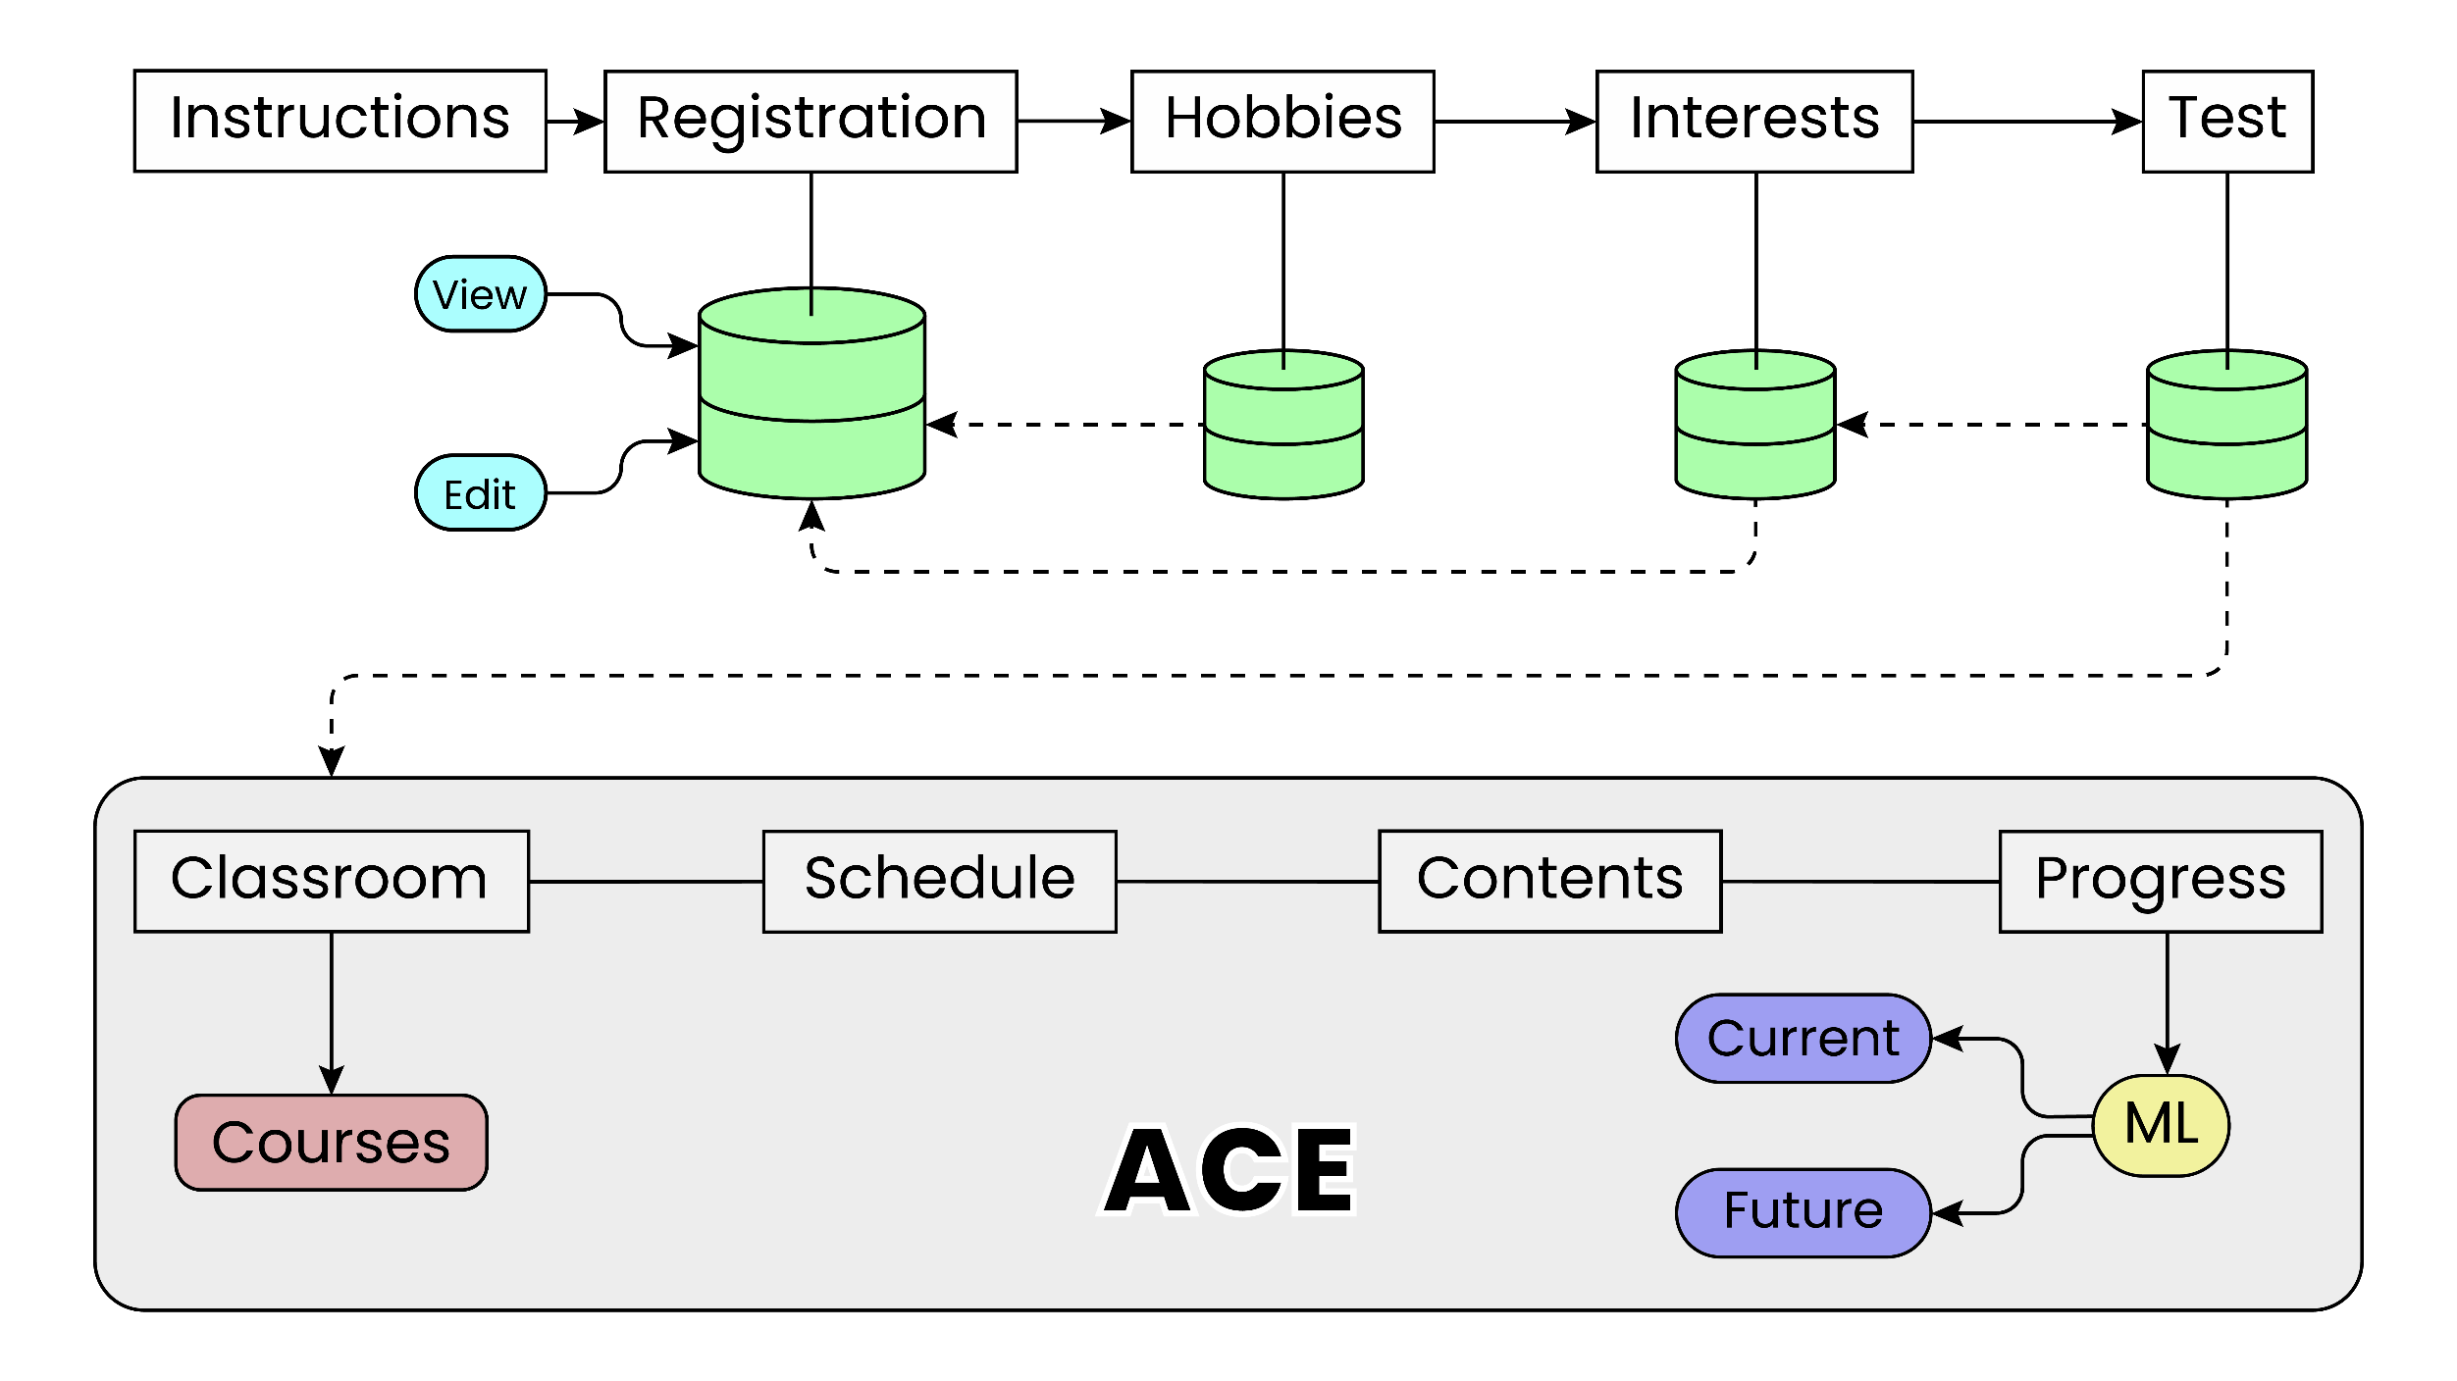
Schema Diagram

Slide 13
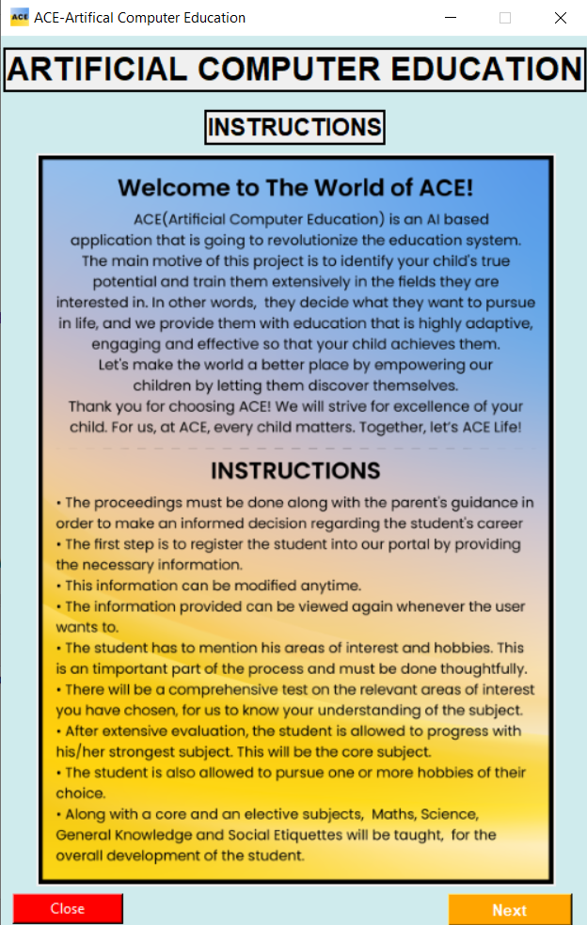
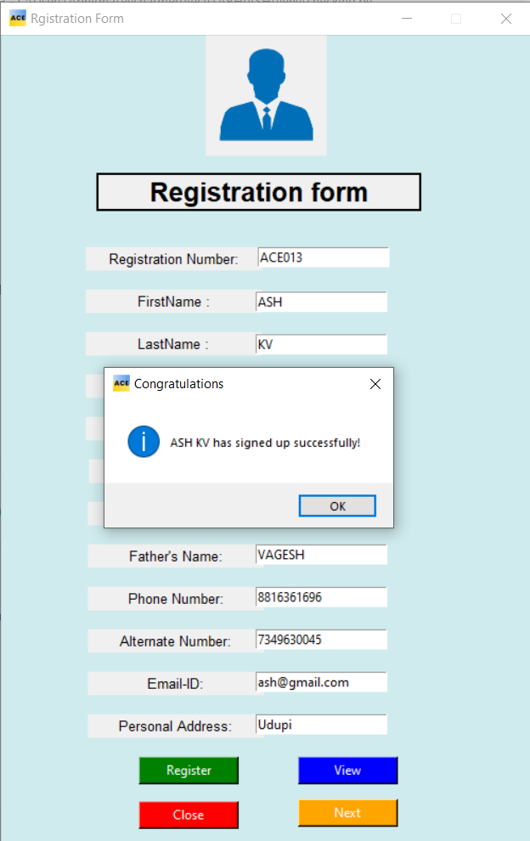
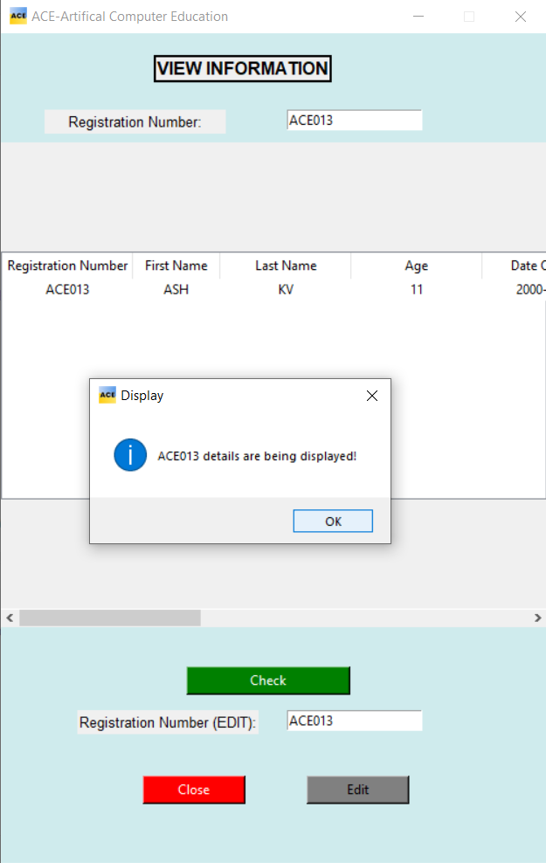
Registration
Registration Process

Slide 14
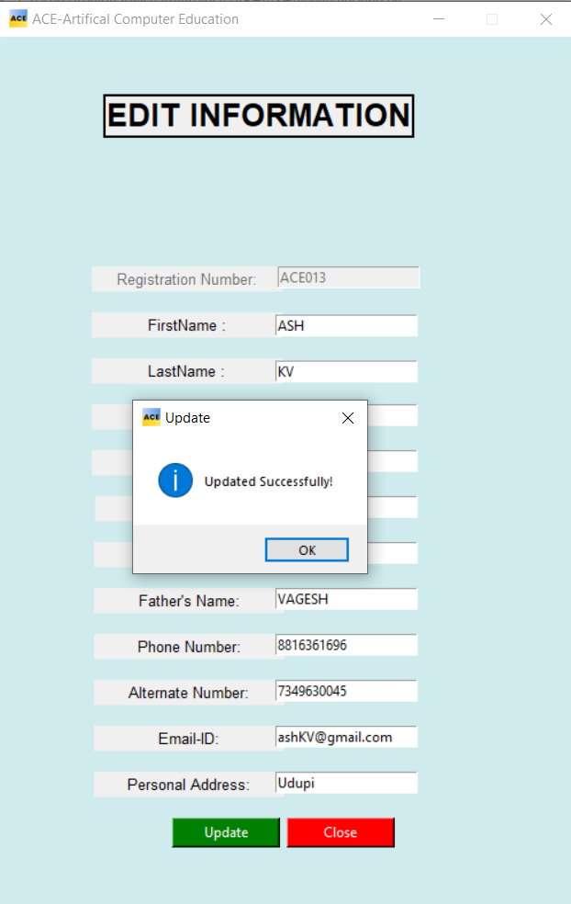
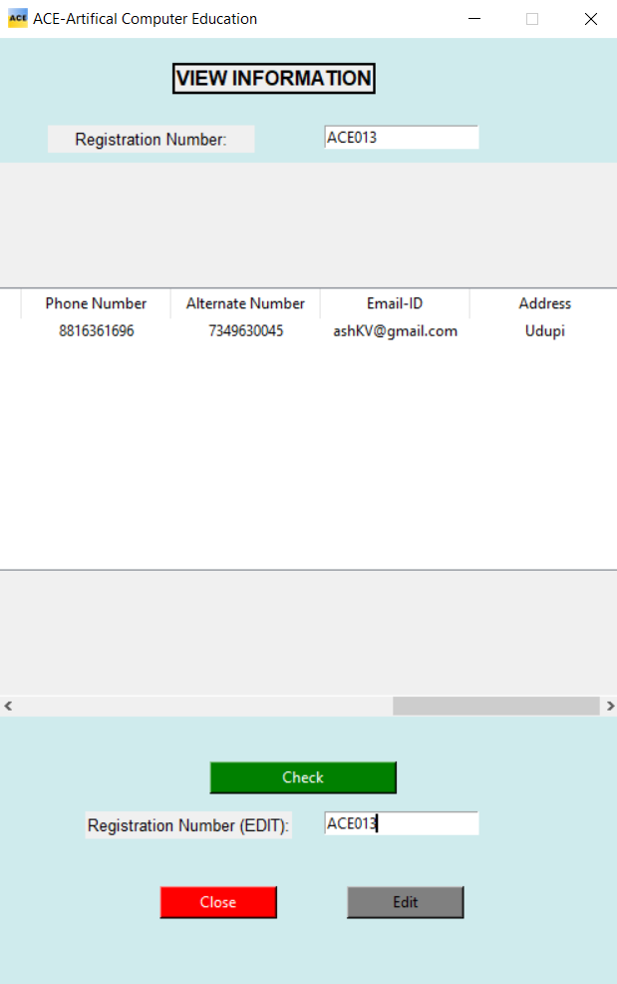
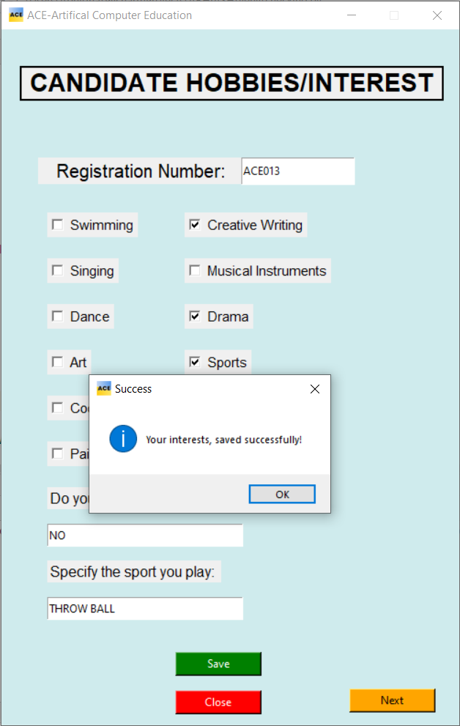

Slide 15
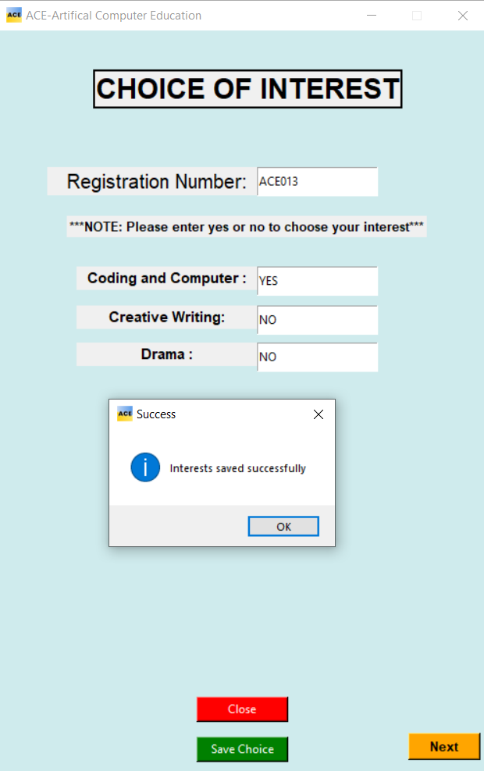
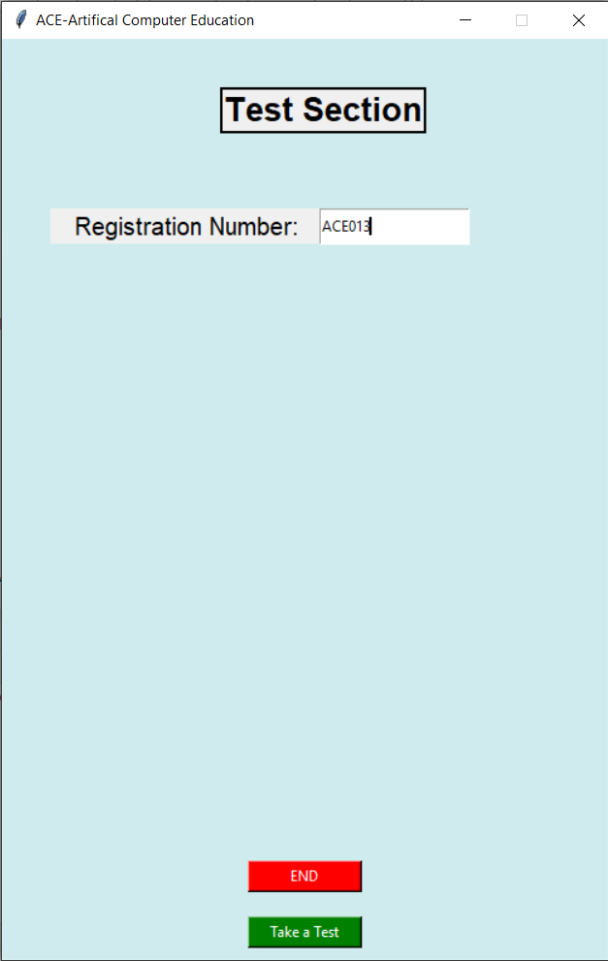
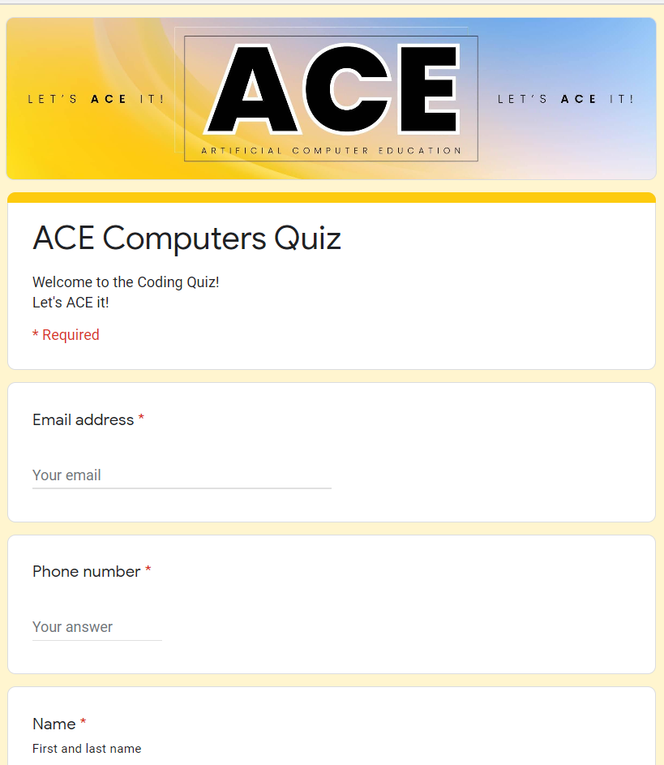

Slide 16
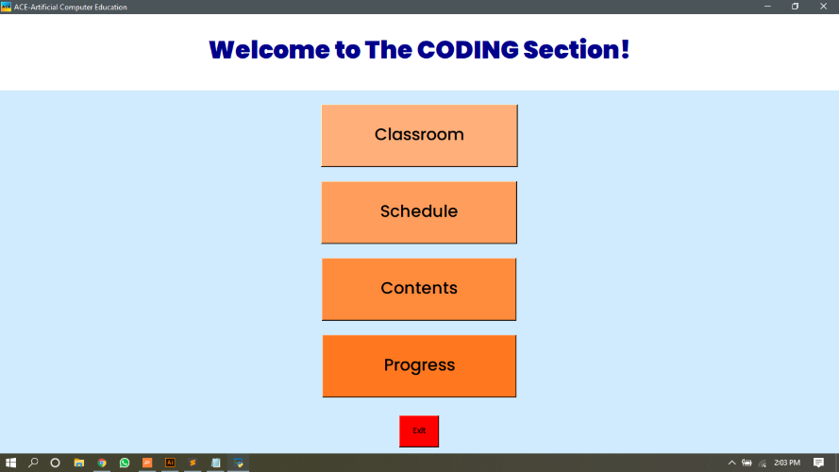
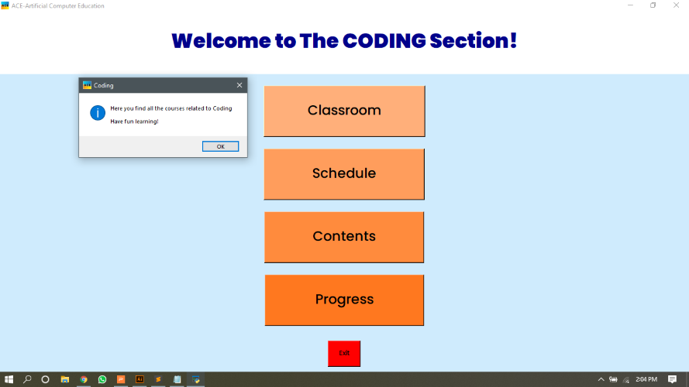
ACE Application
Classroom
Home Screen

Slide 17
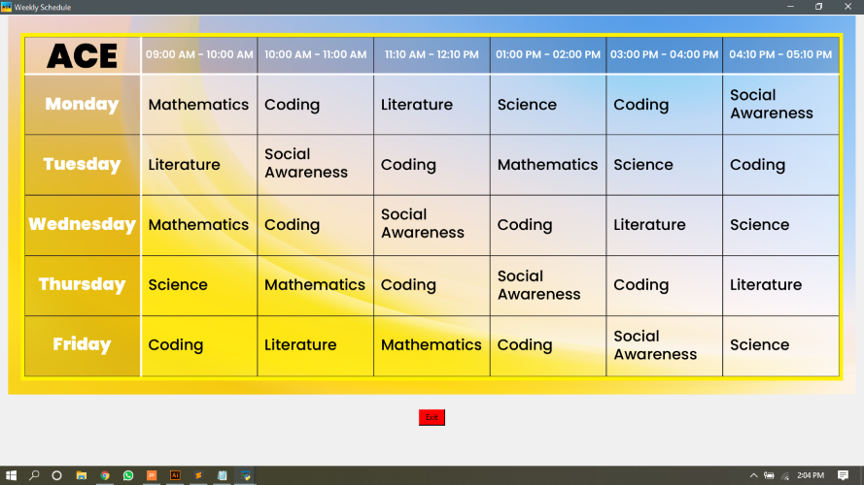
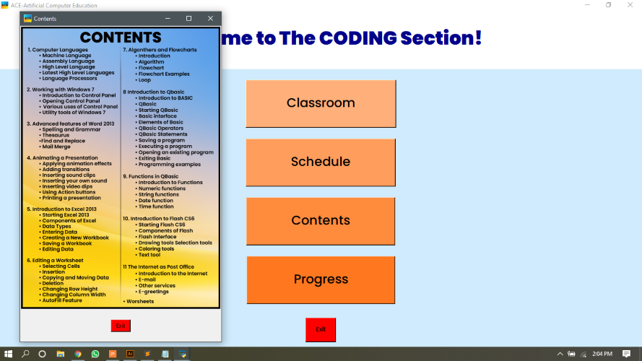
Schedule
Contents

Slide 18
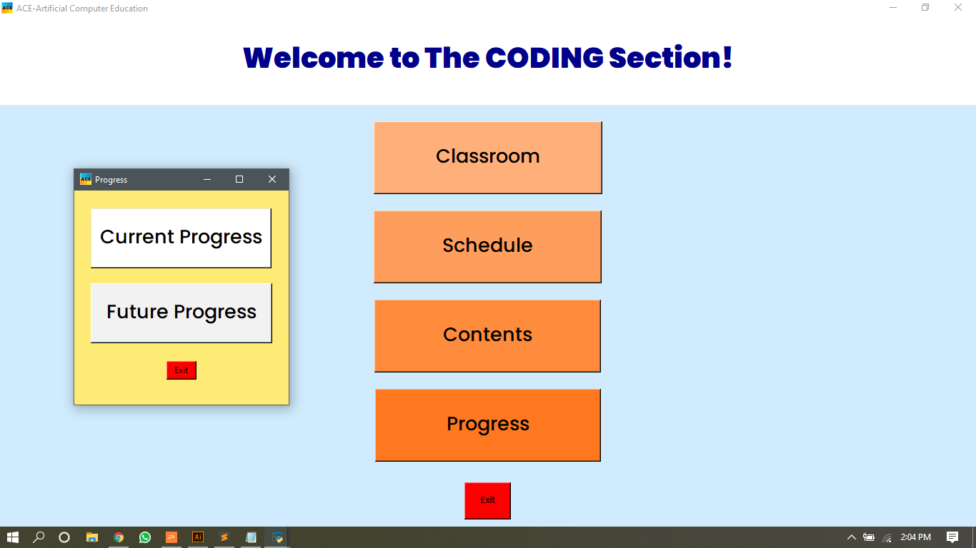
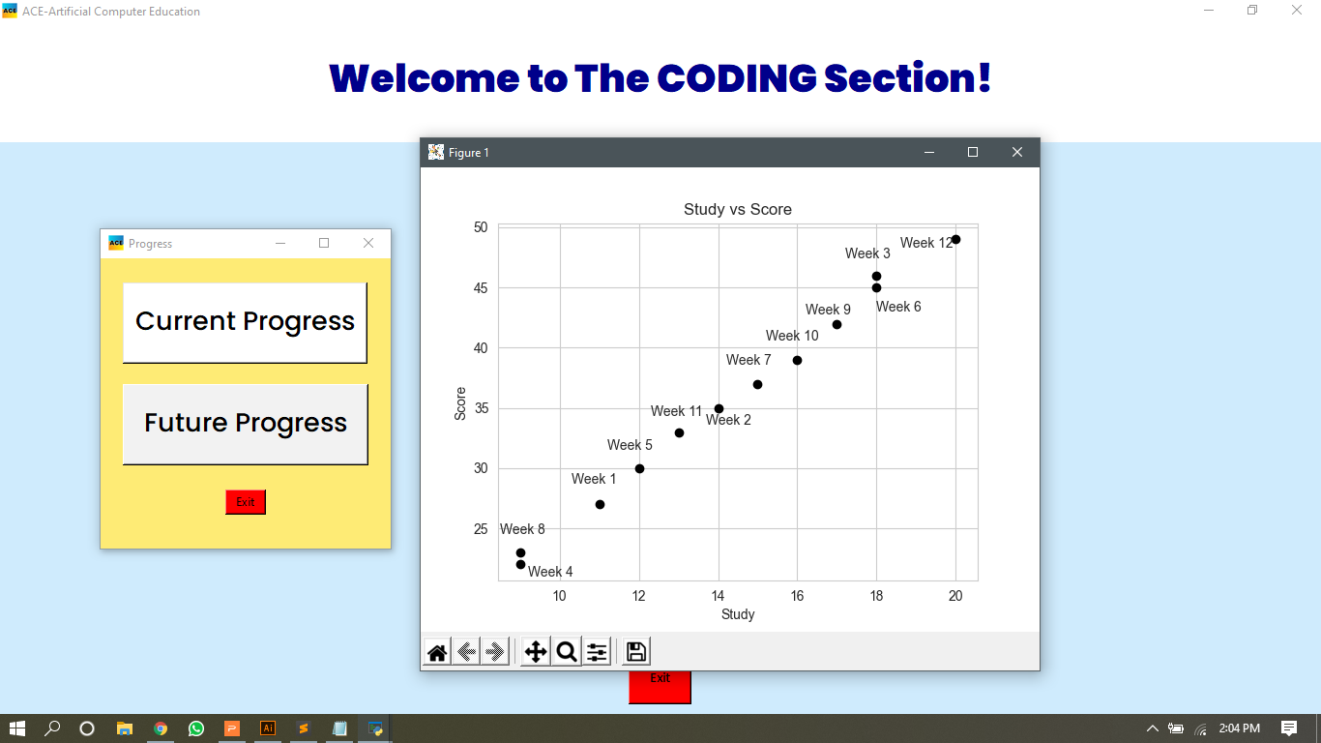
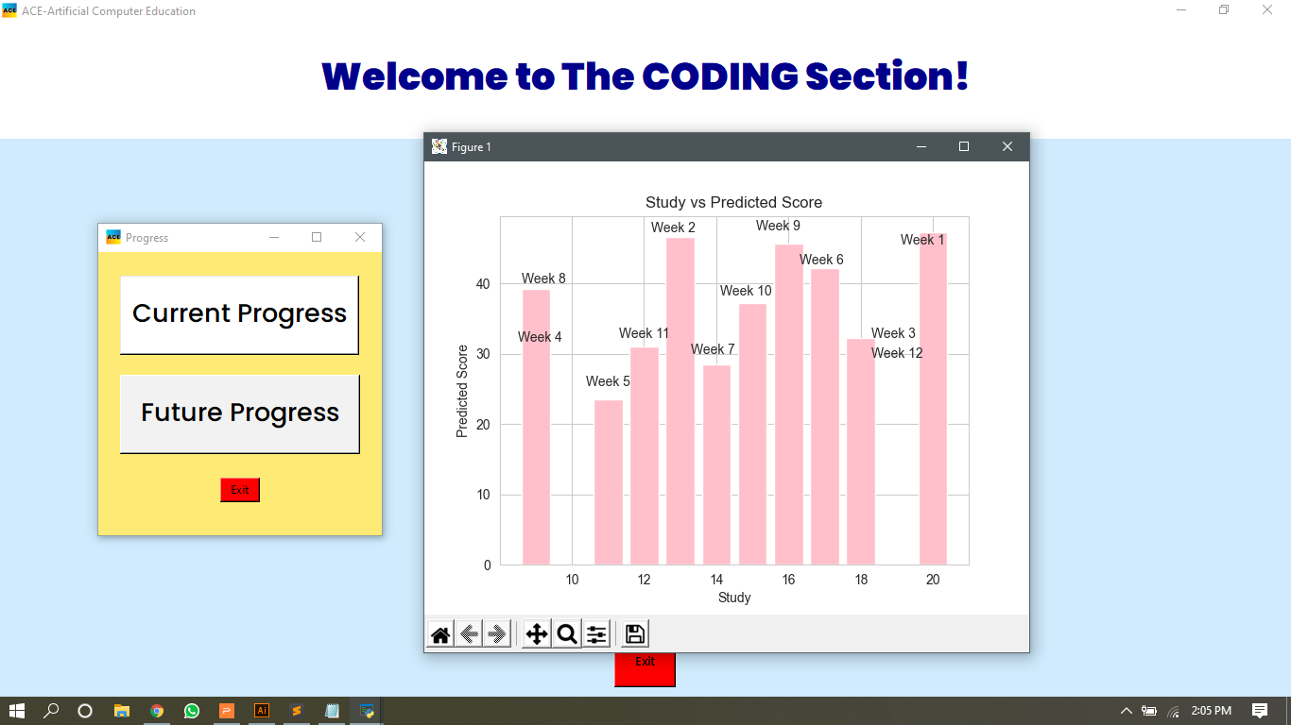
Progress
Current Progress
Future Progress

Slide 19
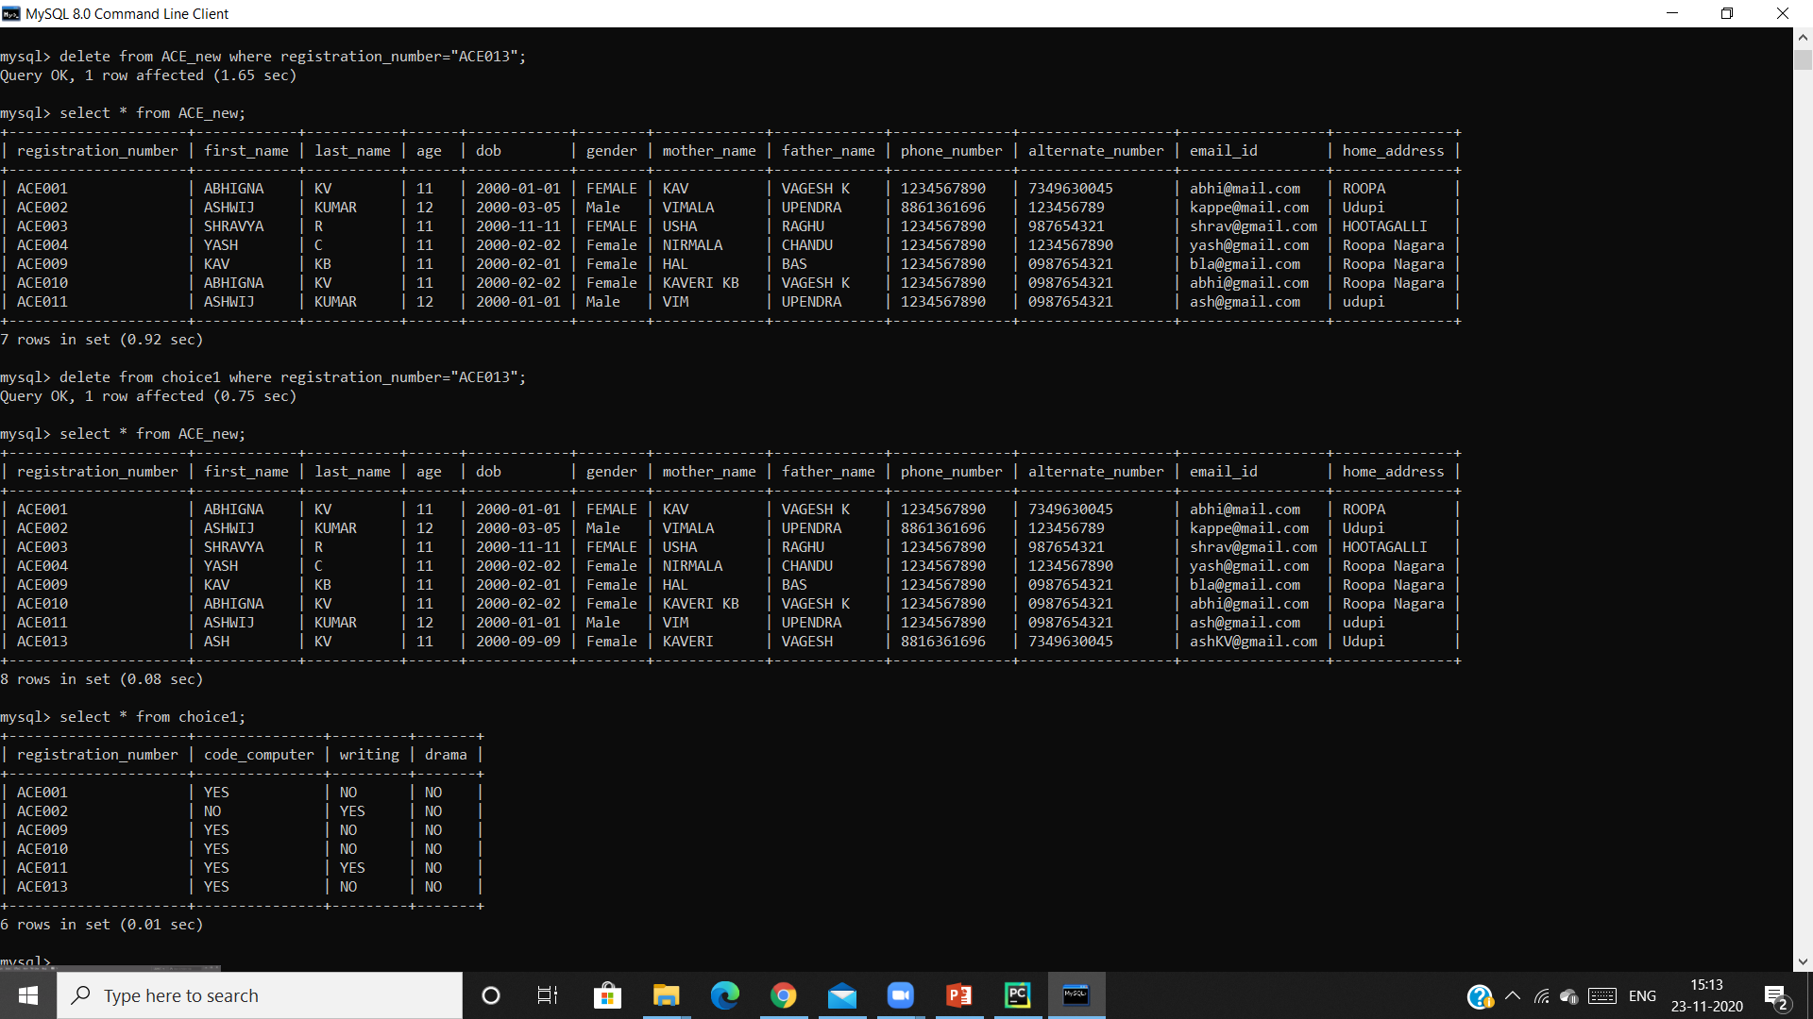
Back-End
Registration Process
Register
Choice of
interest

Slide 20
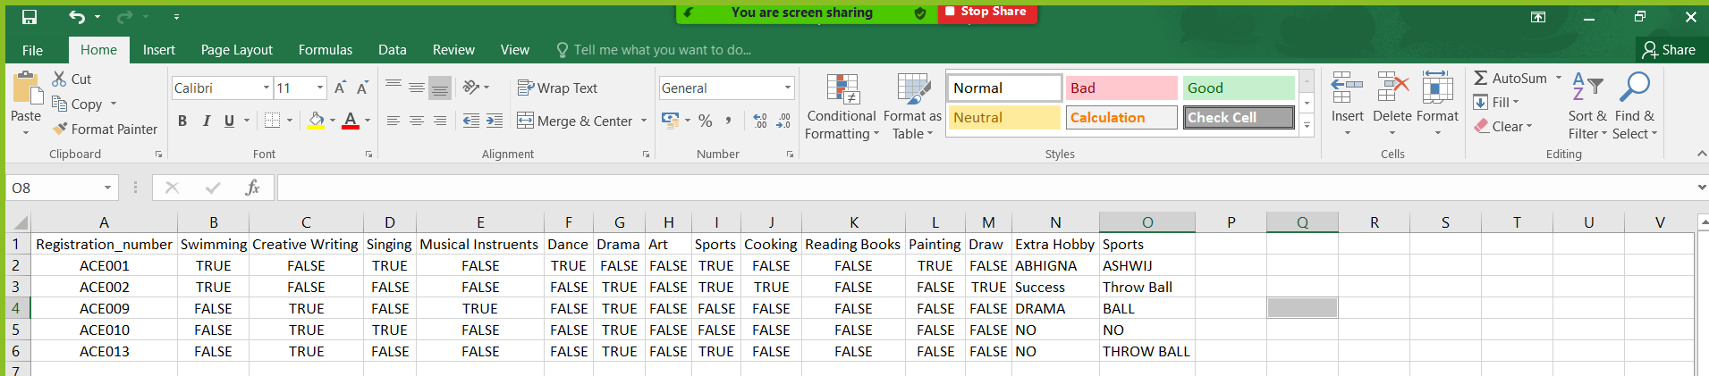
Hobbies

Slide 21
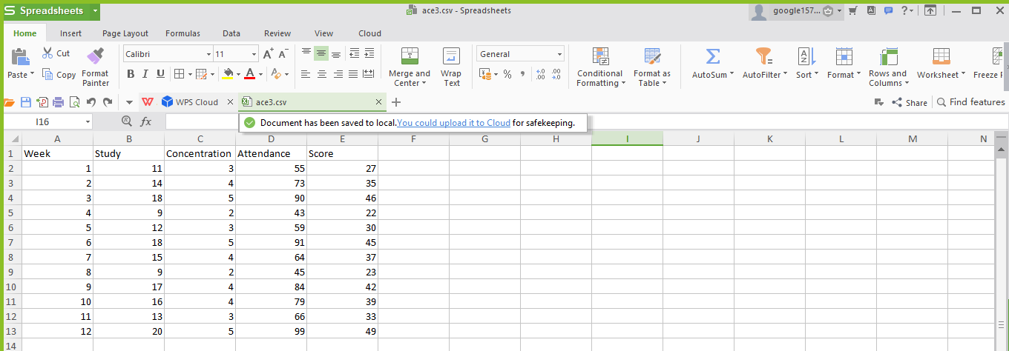
Train and Test Dataset

Slide 22
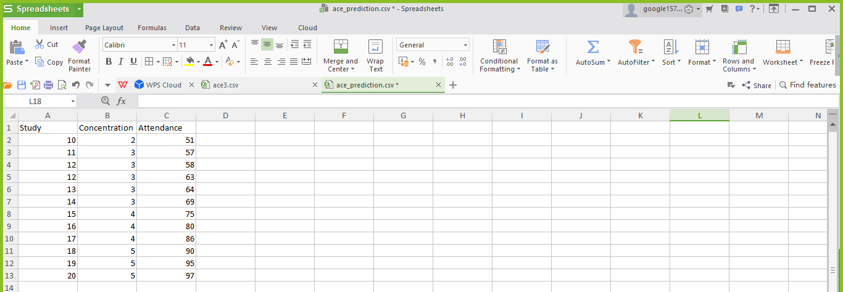
Prediction Dataset

Slide 23
Technologies used
PC Specifications: Core i3, 4GB RAM, 500GB HDD
Language: Python
Python IDE used: PyCharm, Sublime Text

Slide 24
Frequently Asked Questions
Internet is not available or fast enough in all the places. What can be done about that?
This project has a vast area for development, and will need a lot of time to be implemented. By the time a full fledged application is launched, it is safe to assume that tech will be cheaper and internet will be available at every nook and corner.
Is this only limited to online mode?
No. This is not a completely online education system. Some of the programs will be 100% offline, but not all programs are completely online. Because, for practical exposure, online mode is not satisfactory.
What is the algorithm used to predict the scores and why is that particular algorithm used?
Decision Tree vs Random Forest
Random Forest consists of multiple single tress each based on random sample of the training data. It is more accurate than Decision Tree. In RF, the final output is the mean of all outputs of the single tree. Random Forest Handles overfitting the best. Regression vs Random Forest Regression performs well when the noise variables are less than or equal to the number of explanatory variables. And in Random Forest, explanatory variables are higher. Therefore the latter is the better choice.

Slide 25
Future Implementations
An application that can be accessed to all types of devices
Addition of multiple domains
Expert tutors for all specific domains
Both Online and Offline medium of education
Implementation of various criterias to study the students' learning pattern

Slide 26
Team AA
Abhigna KV
abhigna11.11@gmail.com
7349630045
Ashwij Kumar
ashwijkumar4@gmail.com
8861361696
Links
Github Link
Google Drive Link
PS: We were not able to upload our video presentation on Skillenza. The link to the video presentation is given below
VIdeo Presentation Link

Slide 27
Thank You!
LET'S ACE IT!
Team_aa

